Slide 1
A DEEP LEARNING FACIAL EXPRESSION RECOGNITION BASED SCORING SYSTEM FOR RESTAURANTS
GUIDED BY:
Mr. K. Ramesh Chandra
(Associate Professor)
(Department of ECE)
TEAM MEMBERS:
A. Uma Sagar - 18PA1A0407
A. Pradeep Naidu - 18PA1A0404
G. Krupa Raju - 18PA1A0452
B. D. N. Sri Ram - 19PA5A0403

Slide 2
CONCEPTS:
ABSTARCT
INTRODUCTION
PROBLEM DEFINITION
OBJECTIVE
EXISTING SYSTEM
PROPOSED SYSTEM
SYSTEM ARCHITECTURE
DATA FLOW
ALGORITHM
WORKING
DATA BASE
RESULTS
CONCLUSION

Slide 3
ABSTRACT:
Recently, the popularity of automated and unmanned restaurants has increased.
For this purpose, we introduced a rating system based on facial expression recognition with pre-trained convolutional neural network (CNN) models.
For interactive human and computer interface (HCI) it is important that the computer understand facial expressions of human.
With HCI the gap between computers and humans will reduce.
Currently, three expressions (satisfied, neutral and disappointed) are provided by the scoring system.

Slide 4
INTRODUCTION:
Human facial expressions are extremely essential in social communication. Normally communication involves both verbal and nonverbal.
Non-verbal communications are expressed through facial expressions.
Non-verbal communication means communication between human and animals through eye contact, gesture, facial expressions, body language, and paralanguage
FER has the important stage is feature extraction and classification.
Feature extraction includes two types and they are geometric based and appearance based.

Slide 5
PROBLEM DEFINITION:
The problem associated with the reviewing process of gathering the feedback from the customers by the staff.
Due to the absence of staff, there is no direct perception of the customers impressions in order to find out what there experiences with the food.
Due to this it is critical to attain review of the customers concisely.

Slide 6
OBJECTIVE:
The main objective of this project is to implement deep learning model for attaining review of restaurants.
The classification is also one of the important processes in which the above-mentioned expressions such as smile, sad, anger, disgust, surprise, and fear are categorized.
Face expressions are the delicate signals of the larger communication.

Slide 7
EXISTING SYSTEM:
As there is no staff available in unmanned restaurants, it is difficult for the restaurant management to estimate how the food is experienced by the customers.
Existing rating systems, such as Google and TripAdvisor, only partially solve this problem
These rating systems are only used by a subset of the customers who rate the restaurant on independent rating platforms on their own initiative

Slide 8
PROPOSED SYSTEM:
In this project we introduced an approach for a restaurant rating system that captures the human expressions during their visit.
The scoring system is based on facial expression detection using pre-trained convolutional neural network (CNN) models.
It allows the customer to rate the food by taking or capturing a picture of his face that reflects the corresponding feelings.
However, this simple fast and playful rating system gives a wider range of opinions about the experiences of the customers with the restaurant recipes.

Slide 9
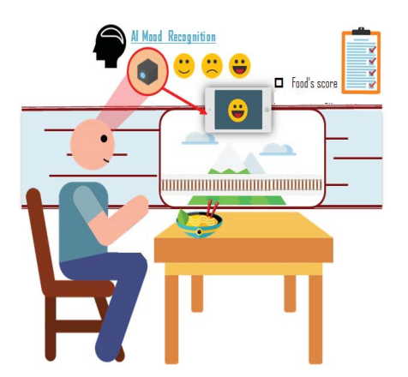
SYSTEM ARCHITECTURE:
Hardware requirements:
Processor : Any Update Processer
Ram : Min 4 GB
Hard Disk : Min 100 GB
Software requirements:
Operating System : Windows family
Technology : Python 3.6
IDE : PyCharm

Slide 10
DATA FLOW:
Web cam
Input image
Face detection
Expression identification
Emotion classification
Output image defining Expressions

Slide 11
ALGORITHM
Viola-Jones Face Detection Technique, popularly known as Haar Cascades.
It is an Object Detection Algorithm used to identify faces in an image or a real time video.
The algorithm uses edge or line detection features proposed by Viola and Jones .
The features on the image makes it easy to find out the edges or the lines in the image, or to pick areas where there is a sudden change in the intensities of the pixels.
The darker areas in the haar feature are pixels with values 1, and the lighter areas are pixels with values 0.
The objective is to find out the sum of all the image pixels lying in the darker area of the haar feature and the sum of all the image pixels lying in the lighter area of the haar feature
If the difference between them is closer to 1. That means, we can say that there is an edge detected if the haar value is closer to 1

Slide 12
WORKING:
Importing all the required libraries.
Write the necessity of each function that is needed to be demonstrated
For example:
to open a camera
to load the data set
By utilising the functions create a file main.py which contains each individual function names

Slide 13
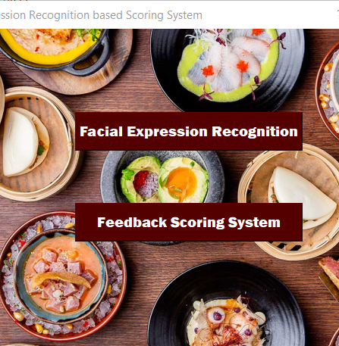
CONTD..
From the function setupui , a new window is being opened which asks for recognition and also shows the feedback which is being stored in data base.

Slide 14
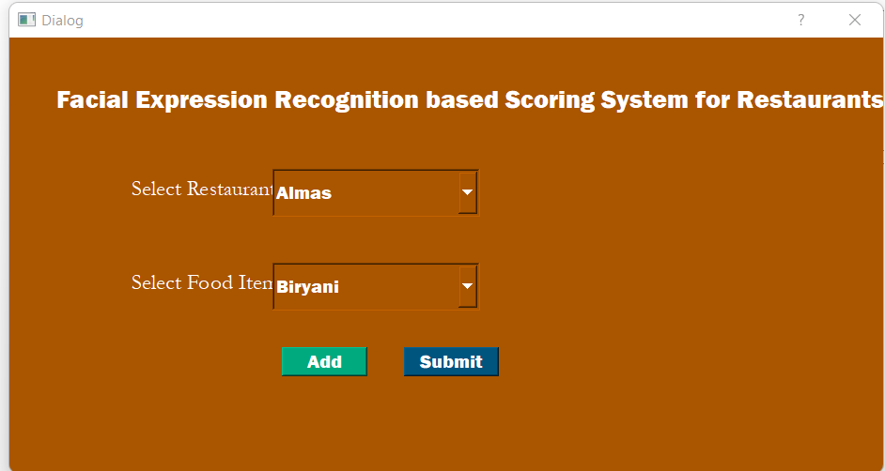
CONTD..
When we are going to click on the facial expression recognition it opens a separate window that asks for to add the food in a particular restaurant.

Slide 15
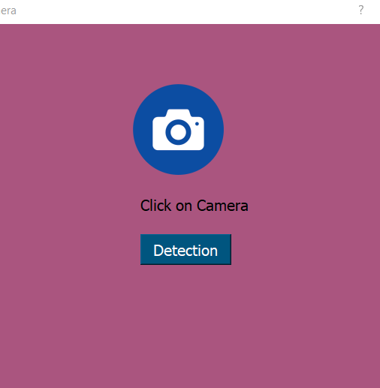
CONTD..
Upon successfully adding the menu on clicking the submit button we are able to open the web camera , thus on clicking the icon we can able to capture the image of the customer

Slide 16
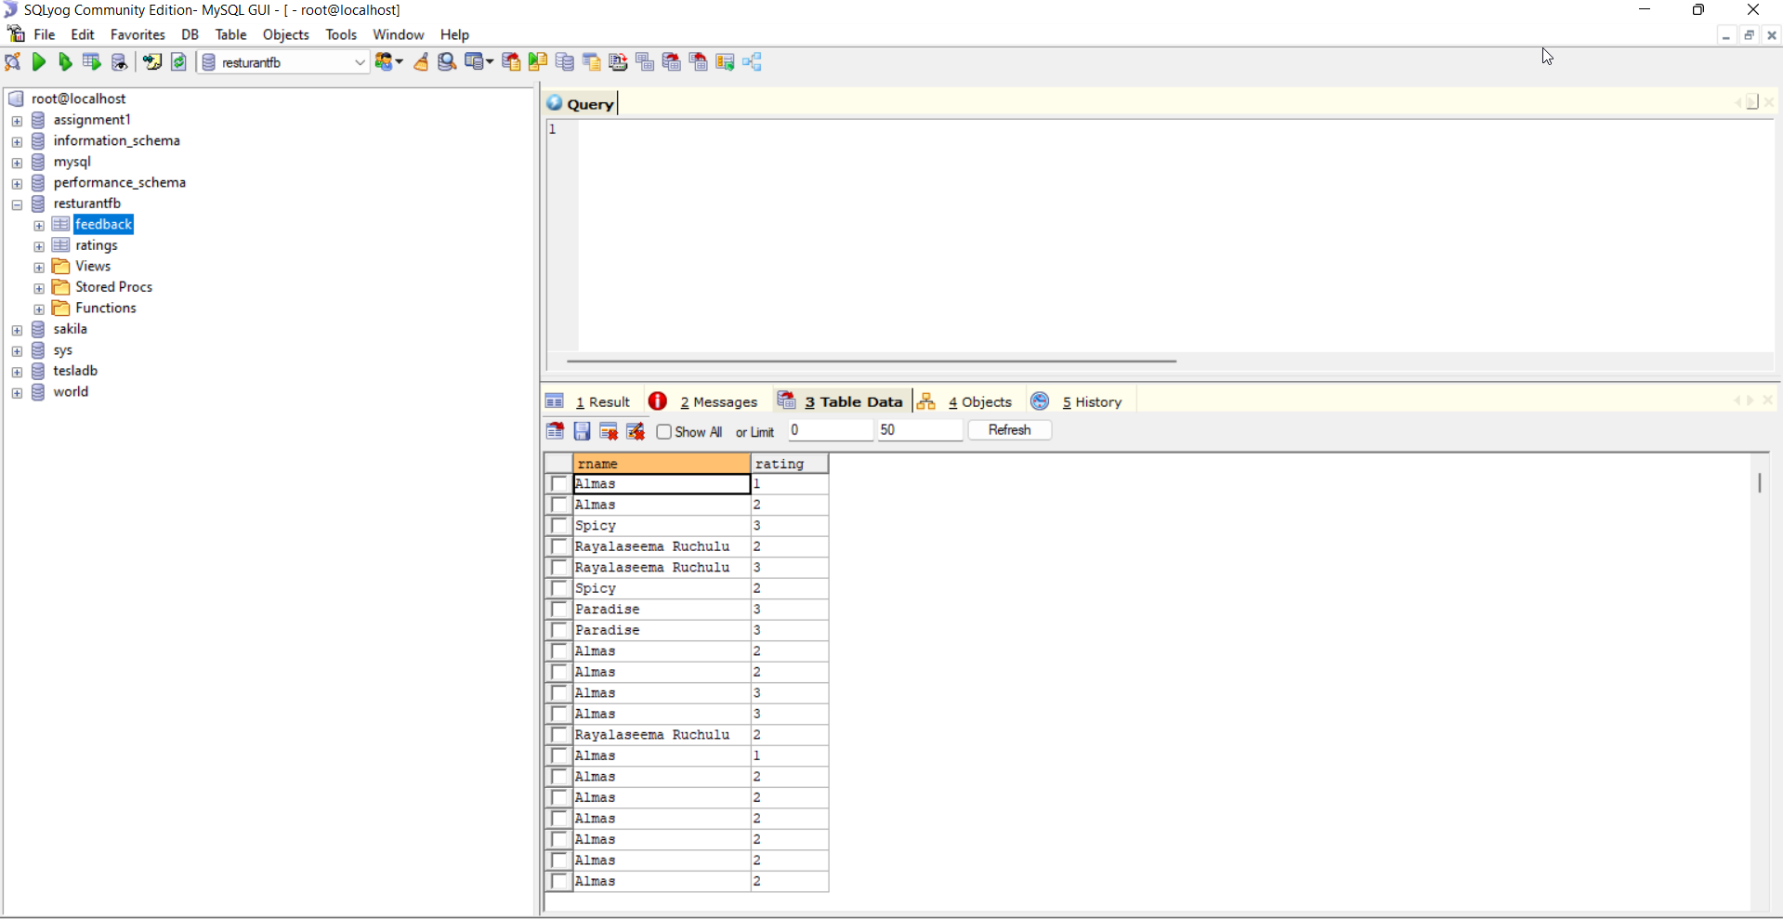
DATA BASE:
As the all procedure that is being done like classifying the emotion of the customer we have to store it.
For that we use SQL database, in which the rating is being given at the end of the execution will be inserted into database by using the insert commands.
So that the final result of the restaurants individual performance can be viewed through the SQL database.

Slide 17
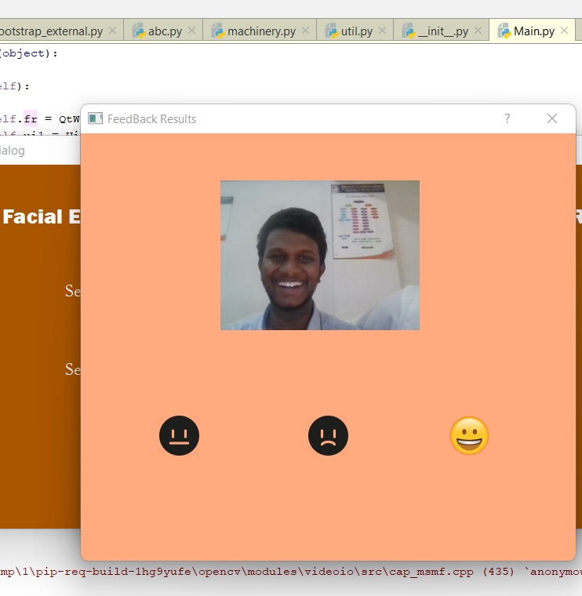
RESULTS:
Based upon the expression that is being detected the code will generate a rating to the restaurant from a scale of 1 to 3.
Here we can use the data that is being stored in the data base and can estimate the restaurants individual rating.

Slide 18
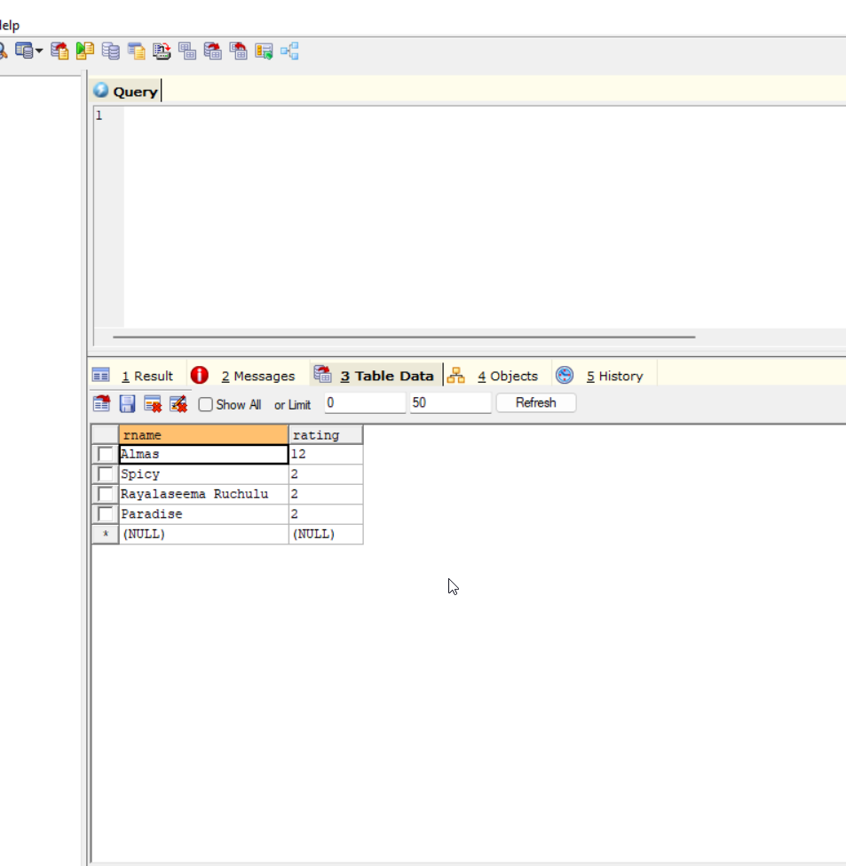
CONTD..
Here we can estimate the restaurants individual performance.

Slide 19
CONCLUSION:
In Our Application we are using to find the human expressions from live webcam, this application can be used in every office and police team in any meeting we can know all the expressing of the human like neutral, sad, happy, anger that will help in know the feeling of the people around the meetings or functions happing at important locations

Slide 20


